Slide 1
Suffix Trees
Charles Yan
2008

Slide 2
Suffix Trees: Motivations
Substring problem: One is given a text T of length m. After O (m) preprocessing time, one must be prepared to take a pattern P of length n as input and find an occurrence of P in T or determine P does not exist in T in O(n) time.
m is a larger number, e.g. the size of human genome.
Multiple patterns input by different users. Thus, can not use exact set matching.
O(m) preprocessing time. After that, each search of P must be done in O(n) time.
Boyer-Moore alg. requires O (m+n) for each input pattern.
Using a suffix tree, it only requires O(n) to find the occurrence of P in T for each P.

Slide 3
Suffix Trees: Motivations
The text T is a fixed set of strings. The goal is to determine whether an input pattern P is a substring of any of the fixed strings in T.
Dictionary problem using keyword tree: whether the input string match a full string in the dictionary. It won’t work in this case.
Suffix trees …

Slide 4
Suffix Trees
Suffix trees can be used to solve in linear time
exact matching problem.
many string problems more complicated than exact matching.
“We know of no other single data structure that allows efficient solutions to such a wide range of complex string problems”

Slide 5
Suffix Trees
A suffix tree T for an m-character string S
A rooted directed tree with exactly m leaves numbered from 1 to m.
Each internal node, other than root, has at least two children and each edge is labeled with a non-empty substring of S.
No two edges out of a node can have edge-labels beginning with the same character.
For any leave i, the concatenation of the edge-labels on the path from the root to leaf i exactly spells out the suffix of S that starts at position i, that is, spells out S[i,…,m]

Slide 6
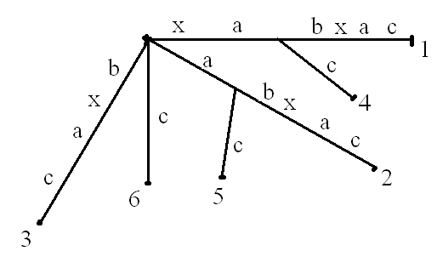
Suffix Trees
The suffix tree for string xabxac

Slide 7
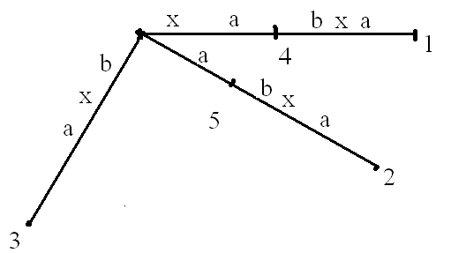
Suffix Trees
What is the suffix tree for string xabxa ?
If one suffix of S matches a prefix of another suffix of S, then no suffix tree satisfying the above definition exists.

Slide 8
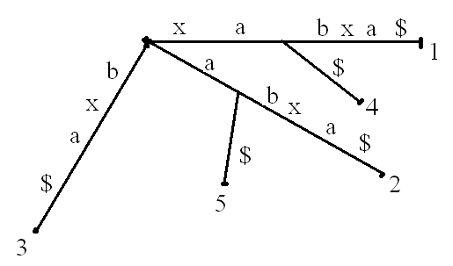
Suffix Trees
To avoid the problem, we add a special character $ to the end of string S.
$ does not appear in S. Thus, no suffix of S$ can be prefix of another suffix of S$.
In this chapter, string S is assumed to be extended with $ even if the symbol is not explicitly shown.
xabxa$

Slide 9
Suffix Trees
Differences between a suffix tree and a keyword tree:

Slide 10
Keyword Trees vs. Suffix Trees
A keyword tree for a set P is a rooted directed tree k satisfying three conditions: (1) each edge is labeled with one character; (2) any two edges out of the same node have distinct labels; and (3) every pattern P_{i} in P maps to some node v of K such that the characters on the path from the root of K to v exactly spell out P_{i} and every leaf of K is mapped to by some pattern in P.
A suffix tree T for an m-character string S
A rooted directed tree with exactly m leaves numbered from 1 to m.
Each internal node, other than root, has at least two children and each edge is labeled with a non-empty substring of S.
No two edges out of a node can have edge-labels beginning with the same character.
For any leave i, the concatenation of the edge-labels on the path from the root to leaf i exactly spells out the suffix of S that starts at position i, that is, spells out S[i,…,m]

Slide 11
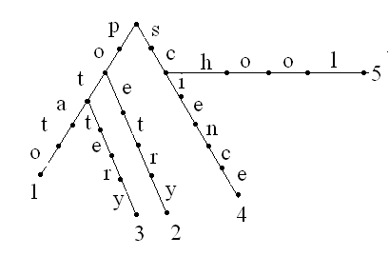
Keyword Trees vs. Suffix Trees
P={potato, poetry, pottery, science, school}
The suffix tree for string xabxac

Slide 12
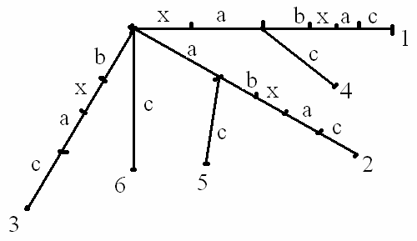
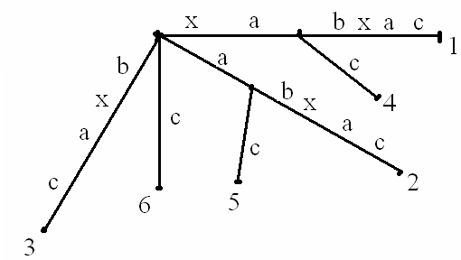
Keyword Trees vs. Suffix Trees
Relationships between a suffix tree and a keyword tree:
For string S, P is the set of suffixes of S.
Construct the keyword tree for set P.
Merge any path of non-branching nodes into a single edge
Then we get the suffix tree of S.
S=xabxac, P={xabxac, abxac, bxac, xac, ac, c}

Slide 13
Suffix Trees
|S|=m, the total lengths of patterns in P is (m+1)*m/2.
The algorithm is O(m²) time.

Slide 14
Suffix Trees
Label of path: from the root to a node (or a point) is the concatenation of all the substrings labeling the edges of that path.
Path-label of a node (Label of a node): The label of the path from the root of T to that node.
String-depth of a node v: the number of characters in v’s label.

Slide 15
Motivating Example
How to use suffix trees for exact matching?
Given a pattern P of length n and a text T of length m.
Build a suffix tree T for text T in O(m) time.
Match the characters of P along the unique path in T , until either (1) P is exhausted or (2) no more matches are possible.
Case 1: Every leaf in the subtree below the point of the last match shows a starting position of P in T
Case 2: P does not occurs in T.

Slide 16
Motivating Example
T: xabxac
P: xa
w

Slide 17
Motivating Example
Time complexity
Build the suffix tree: O(m)
  To be done.
Match P to the unique path: O(n)
  Assume the size of the alphabet is finite.
Traverse the tree below the last matching point: O(k), where k is the number of occurrences, i.e., the number of leaves below the last matching point.
  Easy to prove.
  The substree having k leaves has at most 2k-1 edges.
Overall O(m+n+k).

Slide 18
Suffix Trees
Substring problem: One is given a text T of length m. After O (m) preprocessing time, one must be prepared to take a pattern P of length n as input and find an occurrence of P in T or determine P does not exist in T in O(n) time.
The text T is a fixed set of strings. The goal is to determine whether an input pattern P is a substring of any of the fixed strings in T.

Slide 19
Suffix Trees
String S with length of m.
N_{i}: is the intermediate tree consisting of all suffixes from 1 to i.
Then, N_{m} is the suffix tree we want.
A naïve algorithm to build a suffix tree for string S:
Create a single edge for suffix 1, i.e. S[1,…,m]$
For i=2;i<m;i++
Add suffix i into tree N_{i-1} to create N_{i}
O(m²)

Slide 20
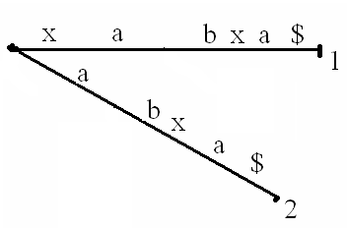
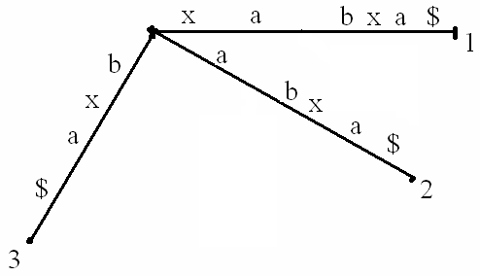

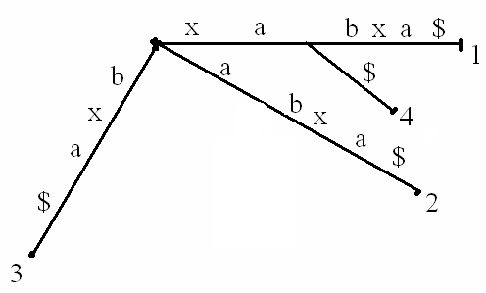
Suffix Trees
S=xabxa$

Slide 21
Suffix Trees
Ukkonen’s algorithm: Linear time construction of suffix trees.
An implicit suffix tree for string S is a tree obtained from the suffix tree for S$ by
(1) removing $ from every leaf;
(2) removing any edge that has no label;
(3) removing any node that has less than two children.
I_{i :} The implicit suffix tree of substring S[1,…i]

Slide 22
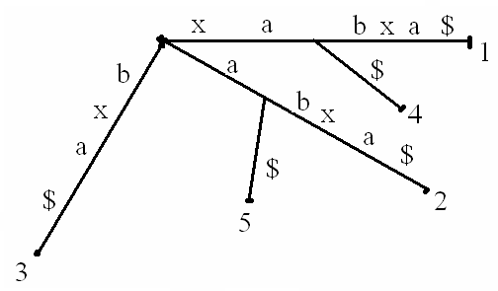
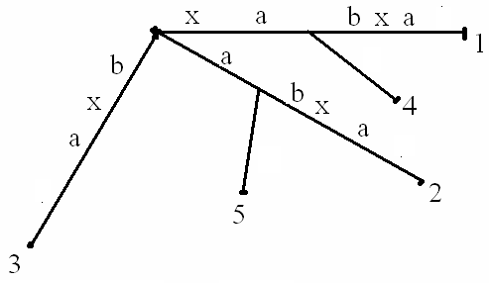
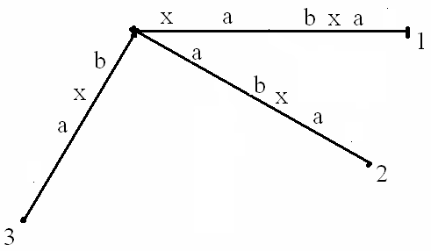
Suffix Trees
I₅ for xabxa$

Slide 23
Suffix Trees
The implicit suffix tree has fewer leaves than the corresponding suffix tree is and only if some suffixes of S is a prefix of another suffix.
Even though an implicit tree may not have a leave for each suffix, it does encode all the suffixes of S.
Each suffix is spelled out by a path from the root to a leaf or the middle of an edge (no marker).
An implicit suffix tree is less informative than the corresponding suffix tree.

Slide 24
Suffix Trees
Construct an implicit suffix tree I_{i} for each prefix S[1,…,i], starting from I₁ and incrementing i by one until I_{m} is built.
The suffix tree for S is constructed from I_{m.}

Slide 25
Ukkonent Algorithm
Input: String S
Output: A suffix tree of S
Ukkonent Alogrithm
Construct tree I_{1.}
For (i=1;i<m;i++) do
begin {phase i+1}
For (j=1;j<i+1;j++) do
begin {extension j}
Find the end of the path from the root labeled S[j…i] in the current tree. If needed extend that path by adding character S[i+1], thus ensuring that string S[j,…,i+1] is in the tree.
end;
end;

Slide 26
Ukkonent Algorithm
I₁ is a tree with a single edge labeled with character S[1].
In phase i+1, tree I_{i+1} is constructed from I_{i.}
In extension j of phase i+1, substring S[j,…,i+1] is added (by extending S[j,…,i]).
After i+1 extensions, S[1,…,i+1], S[2,…,i+1], S[3,…,i+1],…,S[i+1], are added. Thus I_{i+1} is constructed.

Slide 27
Ukkonent Algorithm
In extension j of phase i+1, substring S[j,…,i+1] is added by extending S[j,…,i].
Let β= S[j,…,i],
Rules of extensions
Rule 1: β ends at a leaf in the current tree (I_{i}), add character S[i+1] to the end of β.
Rule 2: At least one labeled path continues from the end of β, but no path starts with character S[i+1], create a new leaf edge starting from the end of β and label the edge with character S[i+1] and the leave with j.
Rule 3: Some labeled path from the end of β starts with character S[i+1]. Do nothing.

Slide 28
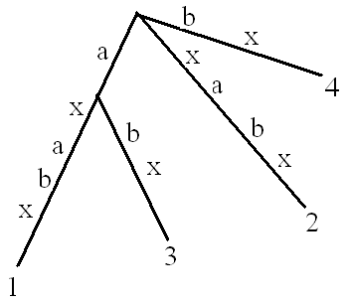
Ukkonent Algorithm
S=axabxb
Phase i+1=6,
extension j=1
Phase i+1=6,
extension j=2
Phase i+1=6,
extension j=3
I₅
b
b
b
b
b
b
Phase i+1=6,
extension j=4
Phase i+1=6,
extension j=5
Phase i+1=6,
extension j=6
b
b
b
b
b
b
5
b
5
b
b
I₆
b
b
b
b
b

Slide 29
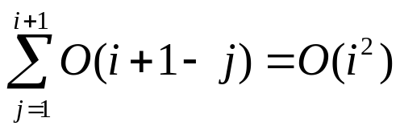
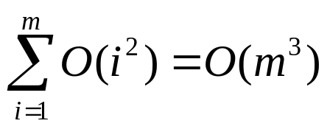
Ukkonent Algorithm
In phase i+1, extension j, once the end of β is found, only constant time is needed to execute the extension rules.
How to locate the end of β?
Naive approach: Start from the root find the end of the path that spell out β.
O(|β|) for a suffix β (each extension).
O(i+1-j) for extension j of phase i+1.
for phase i+1
for m phases (construction of I_{m} from I₁)

Slide 30
Suffix Trees
Construct an implicit suffix tree I_{i} for each prefix S[1,…,i], starting from I₁ and incrementing i by one until I_{m} is built. O (m³) !!! Need to be speeded up to O(m).
The suffix tree for S is constructed from I_{m.}

Slide 31
Ukkonent Algorithm
Suffix links
Let xα denote an arbitrary string, where x denotes a single character and α denotes a (possible empty) substring. For an internal node v with path-label xα, if there is another node s(v) with path-label α, then a pointer from v to s(v) is called a suffix link, denoted as (v,s(v)).
The root has no suffix link from it.
If α is empty, then the suffix link points to
the root.
v
s(v)

Slide 32
Failure Links
v: a node in keyword tree K
L(v): the label on v, that is, the concatenation of characters on the path from the root to v.
lp(v): the length of the longest proper suffix of string L(v) that is a prefix of some pattern in P. Let this substring be α.
Lemma. There is a unique node in the keyword tree that is labeled by string α. Let this node be n_{v}. Note that n_{v} can be the root.
The ordered pair (v, n_{v}) is called a failure link.

Slide 33
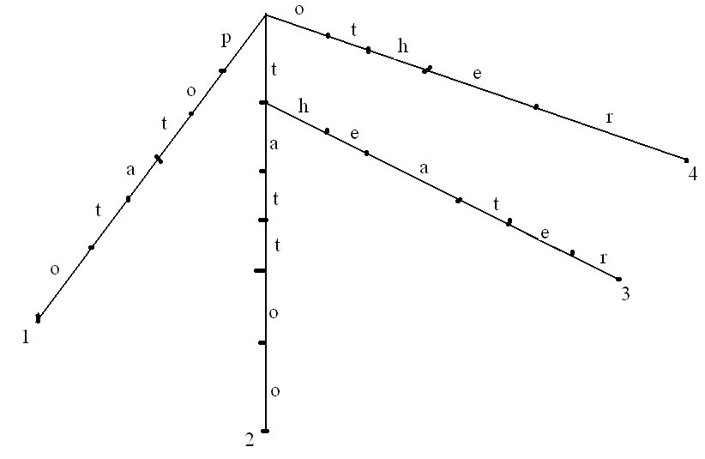
Failure Links
P={potato, tattoo, theater, other}
α
n_{v}
v

Slide 34
Failure Links

Slide 35
Ukkonent Algorithm
Suffix links
Let xα denote an arbitrary string, where x denotes a single character and α denotes a (possible empty) substring. For an internal node v with path-label xα, if there is another node s(v) with path-label α, then a pointer from v to s(v) is called a suffix link, denoted as (v,s(v)).
The root has no suffix link from it.
If α is empty, then the suffix link points to
the root.
This definition does not guarantee every
internal node has a suffix link from it.
v
s(v)

Slide 36
Ukkonent Algorithm
Every internal node in a implicit suffix tree has a suffix link from it.
Lemma 6.1.1 If a new internal node v with path-label xα is created in extension j of phase i+1, then an internal node w with path-label α already exists or will be created in extension j+1 in the same phase i+1.

Slide 37
Ukkonent Algorithm
β
I_{k}
x
α
c
x
α
y
x
α
j
α
l
k
i+1
c
c
Phase i+1
Extension j
Phase i+1
Extension j+1
I_{i}
x
α
α
x
x
y
α
α
α
c
α
c
c
c
y
c
c
y

Slide 38
Ukkonent Algorithm
Any newly created internal node, will have an suffix link from it at the end of next extension.
The extension (j=i+1) (the last extension) of phase i+1 does not create new internal node.
In any implicit suffix tree, every internal node v will have a s(v), i.e., has a suffix link from it.
In any implicit suffix tree I_{i} , if internal node v has a a path-label xα, then there is node s(v) of I_{i} with path-label α.

Slide 39
Ukkonent Algorithm
In phase i+1, extension j, once the end of β is found, only constant time is needed to execute the extension rules.
How to locate the end of β?
Naive approach: Start from the root find the end of the path that spell out β. O(m³)
Use the suffix link.

Slide 40
Ukkonent Algorithm
In the construction of I_{i}, keep a pointer P to leaf 1.
In I_{i} , the path-label of leaf 1 is S[1,…,i]
In the construction of I_{i+1}, the edge leading to leaf 1 will be extended by rule 1.
Leaf 1 in I_{i} will become leaf 1 in I_{i+1.}
The pointer to leaf 1 does not need to be updated.
S=axabxb
Phase i+1=6,
extension j=1
S[1..5]=axabx
S[1..6]=axabxb
I₅
b
p

Slide 41
Ukkonent Algorithm
For phase i+1,
In extension 1, pointer P indicates the end of β.

Slide 42
Ukkonent Algorithm
x
a b c d
Phase i+1
Extension j=1
To add (1,i+1)=xαabcd
β=S(j,i)=xαabc
α
i
I_{i}
x
x
α
α
a
a
a
b
a
b
b
c
b
c
c
p
d
p
c
1
Label (1)=xαabcd
1
Label (1)=xαabc

Slide 43
Ukkonent Algorithm
For phase i+1,
In extension 1, pointer P indicates the end of β.
Let be a pointer pointing to P.
For extension j=2,…i+1, find the end of β by:
  Start with the node (k) that is pointed to by w.
  Walk up one edge and reach node v. let γ be the label of the edge (v,k)
  Follow the suffix link from v and reach s(v). If v is the root, then s(v) is also the root.
  Walk down the path that spells out γ .
  The end of the path is the end of β
  Move w to the end of β

Slide 44
Ukkonent Algorithm
x
a b c d
α
Phase i+1
Extension j=2
Need to add S(2,i+1)=αabcd
β=S(j,i)=αabc
i
I_{i}
x
x
α
α
s(v)
α
v
a
α
s(v)
a
b
v
a
γ
b
c
a
b
p
c
w
b
c
c
w
p
d
d
1
1

Slide 45
Ukkonent Algorithm
λ
x
y
a b c d
α
i
Phase i+1
Extension j=3
Need to add S(3,i+1)=λabcd
β=S(j,i)=λabc
I_{i}
c
d
c
w
a
a
b
a
b
c
a
b
p
c
w
b
c
c
p
d
d
1
1

Slide 46
Ukkonent Algorithm
For phase i+1,
In extension 1, pointer P indicates the end of β.
Let pointer w point to P.
For extension j=2,…i+1, we find the end of β by:
  Starting with the node (k) that is pointed to by w.
  Walk up one edge and reach node v. let γ be the label of the edge (v,k)
    if g is an internal node, there is no need to walk up. v=k
  Follow the suffix link from v and reach s(v).
  Walk down the path that spells out γ .
    If v is the root, (there is no suffix link from the root) then walk down a path that spells out β.
  The end of the path is the end of β
  Move w to the end of β
  If a new node (z) was created in extension j-1, then create the suffix link for z. s(z) is the first internal node above or at pointer w in the current tree.

Slide 47
Ukkonent Algorithm
λ
x
y
a b c d
α
i
Phase i+1
Extension j=3
Need to add S(3,i+1)=λabcd
β=S(j,i)=λabc
I_{i}
c
d
c
w
a
a
b
a
b
c
a
b
p
c
b
c
c
p
d
d
1
1

Slide 48
Ukkonent Algorithm
Input: String S
Output: A suffix tree of S
Ukkonent Alogrithm
Construct tree I_{1.}
For (i=1;i<m;i++) do
begin {phase i+1}
For (j=1;j<i+1;j++) do
begin {extension j}
Find the end of the path from the root labeled S[j…i] in the current tree. If needed extend that path by adding character S[i+1], thus ensuring that string S[j,…,i+1] is in the tree.
end;
end;
How to locate the end of β?
Naive approach: Start from the root find the end of the path that spell out β. O(m³)
Use suffix links: When the tree has no internal at all,
the running time is still O(m³) !!!! ☹

Slide 49
Ukkonent Algorithm
We will be able to reduce the running to O(m) by applying three tricks.
Trick 1. Skip/count trick
The down walk from s(v) takes time proportional to |γ|, i.e. the number of characters that γ consists of.
g be the number of characters that the algorithm needs to walk down.
g starts with |γ|.
h be the index of the character in γ that the edge (e) to be traversed should start with. h starts with 1.
g` be the number of characters on the edge (e) to be traversed.
s(v)
v
a
a
b
γ
b
c
c
p
w
1

Slide 50
Ukkonent Algorithm
If g≥g`, skip to next node; g=g-g`; h=h+g’; e be the edge starts with γ[h]
else, go to the g^{th} character on edge e.
Achievement: the walk down take time proportional to the number of nodes on the path, in stead of the number of characters.
Keep track of the number of characters on each edge.
Move from one node to the other node of an edge in constant time (Adjacency list).
s(v)
v
a
a
b
γ
b
c
c
w
p
h
a
w
1
g=3
h=1, γ[h]=a
g’=2
g=g-g`=1
h=1+g`=3, γ[h]=c
g`=3

Slide 51
Ukkonent Algorithm
Achievement: the walk down take time proportional to the number of nodes on the path, in stead of the number of characters.
Theorem 6.1.1. Using the skip/count trick, any phase of Ukkonent Algorithm takes O(m) time.
This is an improvement over the naive approach, which takes O(m²) for each phase.

Slide 52
Ukkonent Algorithm
In phase i+1, extension j, once the end of β is found, only constant time is needed to execute the extension rules.
How to locate the end of β?
Naive approach: Start from the root find the end of the path that spell out β.
O(|β|) for a suffix β (each extension).
O(i+1-j) for extension j of phase i+1.
for phase i+1
for m phases (construction of I_{m} from I₁)

Slide 53
Ukkonent Algorithm
Still need to prove Theorem 6.1.1
The node depth of a node u is the number of nodes on the path from the root to u.
Lemma 6.12. Let (v, s(v)) be a suffix link, then the node depth of v is at most one greater than the node depth of s(v).

Slide 54
Ukkonent Algorithm
Label (v)=xα Label (s(v))=a
Label (u)=xβ Label (s(u))=β
(v,s(v)) is a suffix link.
The suffix link from any internal ancestor of v goes to an ancestor of s(v).
x
β
s(u)
u
α
α
s(v)
v
a
a
b
b
c
c
d

Slide 55
Ukkonent Algorithm
(v,s(v)) is a suffix link.
The suffix link from any internal ancestor of v goes to an ancestor of s(v).
The only extra ancestor that v can have is the internal node whose label consists of only one character.
Thus, v can have at most one more ancestor than s(v).
The node depth of v is at most one greater than the node depth of s(v).
On the other hand, s(v) have more ancestors than v.
a
s(v)
v

Slide 56
Ukkonent Algorithm
As the algorithm proceeds, the current node depth (cd) of the algorithm is the node depth of the node most recently visited by the algorithm.
Theorem 6.1.1. Using the skip/count trick, any phase of Ukkonent Algorithm takes O(m) time.
Only need to analyze the time for down-walks.
In extension j of phase i+1
Up-walk
decreases by at most 1
Traverse
decreases by at most 1
down-walk
increase by n_{j}, the number of nodes walk down.,
s(v)
v
a
a
b
γ
b
c
c
p
w
1

Slide 57
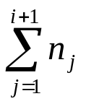
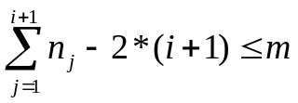

Ukkonent Algorithm
As the algorithm proceeds, the current node depth (cd) of the algorithm is the node depth of the node most recently visited by the algorithm.
Theorem 6.1.1. Using the skip/count trick, any phase of Ukkonent Algorithm takes O(m) time.
Then in the entire phase i+1,
The total decrement is at most 2*(i+1)
The total increment is
Since cd≤m at any time,
Walks down O(m) nodes in phase i+1
The total time for all down-walks in a phase is O(m)
s(v)
v
a
a
b
γ
b
c
c
p
w
1

Slide 58
Ukkonent Algorithm
Ukkonent algorithm can be implemented with suffix links to run in O(m²) time.

Slide 59
Keyword Trees vs. Suffix Trees
Relationships between a suffix tree and a keyword tree:
For string S, P is the set of suffixes of S.
Construct the keyword tree for set P.
Merge any path of non-branching nodes into a single edge
Then we get the suffix tree of S.
S=xabxac, P={xabxac, abxac, bxac, xac, ac, c}

Slide 60
Suffix Trees
|S|=m, the total lengths of patterns in P is (m+1)*m/2.
The algorithm is O(m²) time.
O(m²)→ O(m²) ☹!!!

Slide 61
Ukkonent Algorithm
For a string S with m characters, its suffix tree has O(m²) characters!
S=abcdefghij…xyz
To output a O(m²) tree in O(m) time…
Mission impossible!
Need to find alternate representation of the tree that takes only O(m) space.
Edge label compression: Label each edge with a pair of indices, specifying the beginning and end positions of the edge label in S

Slide 62
Ukkonent Algorithm
S=abcdefabcuvw
a
2,3
b
1,3
b
c
c
u
4,6
d
d
u
10,12
10,12
v
4,6
e
v
e
f
w
f
w
At most m leaves
At most 2m-1 edges
O(m) space

Slide 63
Ukkonent Algorithm
In extension j of phase i+1, substring S[j,…,i+1] is added by extending S[j,…,i].
Let β= S[j,…,i],
Rules of extensions
Rule 1: β ends at a leaf in the current tree (I_{i}), add character S[i+1] to the end of β. Change the edge label from (p,q) to (p, q+1)
q=i, i.e., from (p,i) to (p,i+1)
Rule 2: At least one labeled path continues from the end of β, but no path starts with character S[i+1], create a new leaf edge starting from the end of β and label the edge with character S[i+1] and the leave with j. The newly created edge is labeled with (i+1,i+1)
Rule 3: Some labeled path from the end of β starts with character S[i+1]. Do nothing.

Slide 64
Ukkonent Algorithm
Observation 1. Rule 3 is a show stopper.
In any phase i+1, if rule 3 applies in extension j, it will also apply in all further extensions (j+1 to i+1).

Slide 65
Ukkonent Algorithm
γ
x y z
α
a b c d
γ
x y z
α
a b c d
l
β₁
k
j
β₁
i
β₂
β₂
β₃
β₃
I_{k}
β₁
Phase i+1
Extension j
S(j,i+1)=xyzαabcd
β₁ =S(j,i)=xyzαabc
Phase i+1
Extension j+1
S(j+1,i+1)=yzαabcd
β₂ =S(j+1,i)=yzαabc
Phase i+1
Extension j+2
S(j+2,i+1)=zαabcd
β₃ =S(j+2,i)=zαabc
β₂
β₃
d
d
d
Rule 3 → β₁d is in I_{i}
I_{i+1}
β₂d is in I_{i}→ Rule 3
I_{i}
β₁
β₂
β₃
β₃d is in I_{i}→ Rule 3
d
d
d
d

Slide 66
Ukkonent Algorithm
Observation 1. Rule 3 is a show stopper.
In any phase i+1, if rule 3 applies in extension j, it will also apply in all further extensions (j+1 to i+1).
Trick 2.
In any phase i+1, if rule 3 applies in extension j, then end that phase and go to the next phase.
Extensions j+1,…,i+1 are done implicitly.
Extensions 1, …, j are done explicitly. Explicit extensions.

Slide 67
Ukkonent Algorithm
Phase | Extension
 | 1 | 2 | 3 | 4 | 5 | 6 | 7 | 8 | 9 | … | i | i+1 | i+2 | …
i | 1 | 2 | 1 | 2 | 3 | 3 | 3 | 3 | 3 | … | 3
i+1 | 1 | 1 | 1 | 1 | 2 | 1 | 3 | 3 | 3 | … | 3 | 3
i+2 | 1 | 1 | 1 | 1 | 1 | 1 | 2 | 2 | 3 | … | 3 | 3
…

Slide 68
Ukkonent Algorithm
Observation 2. Once a leaf always a leaf.
If at some point in the Ukkonent algorithm a leaf is created and labeled with j in extension j of phase i (rule 2 applies), then in extension j of phase i+1, that leaf will be extended by adding a new character to the edge label (rule 1 applies).
Rule 2 applies in extension j of phase i → rule 1 applies in extension j of phase i+1.

Slide 69
Ukkonent Algorithm
Phase i+1=6,
extension j=1
Phase i+1=6,
extension j=2
Phase i+1=6,
extension j=3
S=axabxbd
I₅
I₆
b
b
b
b
b
b
Phase i+1=6,
extension j=4
Phase i+1=6,
extension j=5
Phase i+1=6,
extension j=6
b
b
b
Phase i+1=7,
extension j=5
b
b
b
5
b
5
b
b
b
b
b
b
b
b d
b
d
5
b d
b
b d
c

Slide 70
Ukkonent Algorithm
Observation 2. Once a leaf always a leaf.
If at some point in the Ukkonent algorithm a leaf is created and labeled with j in extension j of phase i (rule 2 applies), then in extension j of phase i+1, that leaf will be extended by adding a new character to the edge label (rule 1 applies).
Rule 2 applies in extension j of phase i → rule 1 applies in extension j of phase i+1.
Once leaf j is created, it will remain leaf j in all successive trees created.
Rule 1 applies in extension j of phase i → rule 1 applies in extension j of phase i+1.

Slide 71
Ukkonent Algorithm
Phase i+1=6,
extension j=1
Phase i+1=6,
extension j=2
Phase i+1=6,
extension j=3
S=axabxbd
I₅
I₆
b
b
b
b
b
b
Phase i+1=6,
extension j=4
Phase i+1=6,
extension j=5
Phase i+1=6,
extension j=6
b
b
b
Phase i+1=7,
extension j=1,…4
b
b
b
5
b
5
b
b
b
b
b
b
b
b d
b
5
b
b
d
b
d
d

Slide 72
Ukkonent Algorithm
Phase | Extension
 | 1 | 2 | 3 | 4 | 5 | 6 | 7 | 8 | 9 | … | i | i+1 | i+2 | …
i | 1 | 2 | 1 | 2 | 3 | 3 | 3 | 3 | 3 | … | 3
i+1 | 1 | 1 | 1 | 1 | 2 | 1 | 3 | 3 | 3 | … | 3 | 3
i+2 | 1 | 1 | 1 | 1 | 1 | 1 | 2 | 2 | 3 | … | 3 | 3 | 3
…

Slide 73
Ukkonent Algorithm
In any phase i, there is an initial sequence of consecutive extensions (starting with extension 1) where rule 1 or 2 applies. Let j_{i} denotes the last extension of this sequence.
This sequence can not shrink in successive phases. j_{i+1}≥j_{i}

Slide 74
Ukkonent Algorithm
Phase | Extension
 | 1 | 2 | 3 | 4 | 5 | 6 | 7 | 8 | 9 | … | i | i+1 | i+2 | …
i | 1 | 2 | 1 | 2 | 3 | 3 | 3 | 3 | 3 | … | 3
i+1 | 1 | 1 | 1 | 1 | 2 | 1 | 3 | 3 | 3 | … | 3 | 3
i+2 | 1 | 1 | 1 | 1 | 1 | 1 | 2 | 2 | 3 | … | 3 | 3 | 3
…
j_{i}
j_{i+1}
j_{i+2}

Slide 75
Ukkonent Algorithm
Trick 3. Keep a global variable e. When the Ukkonent algorithm steps into phase i+1, e is set to i+1.
In phase i+1, a leaf edge would normally be labeled with substring S[p, i+1], instead of writing indices (p, i+1) on the edge, write (p,e).
Thus, in phase i+1, once e is updated, all leaf edges are updated implicitly

Slide 76
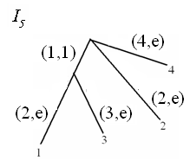
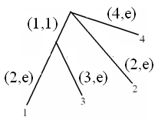
Ukkonent Algorithm
Phase i+1=6,
extension j=1
Phase i+1=6,
extension j=2
Phase i+1=6,
extension j=3
S=axabxbd
I₅
I₆
b
b
b
b
b
b
Phase i+1=6,
extension j=4
e=5
e=6
b
b
b
b

Slide 77
Ukkonent Algorithm
Trick 3. Keep a global variable e. When the Ukkonent algorithm steps into phase i+1, e is set to i+1.
In phase i+1, a leaf edge would normally be labeled with substring S[p, i+1], instead of writing indices (p, i+1) on the edge, write (p,e).
Thus, in phase i+1, once e is updated, all leaf edges are updated implicitly
All the extensions in which rule 1 applies will be done implicitly by updating e.
In phase i+1, extensions 1 through j_{i} will be done implicitly by updating e.

Slide 78
Ukkonent Algorithm
Phase | Extension
 | 1 | 2 | 3 | 4 | 5 | 6 | 7 | 8 | 9 | … | i | i+1 | i+2 | …
i | 1 | 2 | 1 | 2 | 3 | 3 | 3 | 3 | 3 | … | 3
i+1 | 1 | 1 | 1 | 1 | 2 | 1 | 3 | 3 | 3 | … | 3 | 3
i+2 | 1 | 1 | 1 | 1 | 1 | 1 | 2 | 2 | 3 | … | 3 | 3 | 3
…
j_{i}
j_{i+1}
j_{i+2}

Slide 79
Ukkonent Algorithm
In phase i+1,
Extensions 1 through j_{i} are done explicitly by updating e;
Explicitly compute extensions starting from j_{i}+1, until the first extension (let it be j*) where rule 3 applies;
Set j_{i+1}=j*-1 to prepare for the next phase.

Slide 80
Ukkonent Algorithm
Input: String S of m characters
Output: Implicit suffix tree I_{m} of S
Ukkonent Alogrithm
e=1; j₁=1;
Construct tree I_{1.}
For (i=1;i<m;i++) do
begin {phase i+1}
e=i+1; (this will correctly implement extension 1 through j_{i})
j*=i+2;
For (j=j_{i}+1; j <i+1; j++) do
begin {extension j}
Find the end of the path from the root labeled S[j…i]. (up-walk, traversal, down-walk)
Apply one of the extension rules to ensure that string S[j,…,i+1] is in the tree.
If rule 3 is applies, then go to next phase and j*=j;
(Explicitly compute extensions starting from j_{i} until the first extension where rule 3 applies).
end;
j_{i+1}=j*-1;
end;

Slide 81
Ukkonent Algorithm
Phase | Extension
 | 1 | 2 | 3 | 4 | 5 | 6 | 7 | 8 | 9 | … | i | i+1 | i+2 | …
i | 1 | 2 | 1 | 2 | 3 | 3 | 3 | 3 | 3 | … | 3
i+1 | 1 | 1 | 1 | 1 | 2 | 1 | 3 | 3 | 3 | … | 3 | 3
i+2 | 1 | 1 | 1 | 1 | 1 | 1 | 2 | 2 | 3 | … | 3 | 3 | 3
…
j_{i}
j*
j_{i+1}
j*
j_{i+2}
j*

Slide 82
Ukkonent Algorithm
In phase i+1, extension j_{i}+1 (the last extension that are explicitly computed in phase i),
How to find the end of β (i.e., S [j_{i}+1, i]) ? (we can not start from pointer p that points to 1).
The end of β is where the algorithm stops in the previous phase (pointed to by w). (in extension j_{i}+1 of phase i, S [j_{i}+1, i] was added to the tree).
There is no need to search for it explicitly.

Slide 83
Ukkonent Algorithm
x
a b c d
α
Phase i+1
Extension j=j_{i}+1
Need to add
S(j_{i}+1,i+1)=αabcd
β=S(j_{i}+1,i)=αabc
i
Phase i
Extension j= j_{i}+1
add S(j_{i}+1,i)=αabc
x
x
α
α
s(v)
α
v
a
α
s(v)
a
b
v
a
γ
b
c
a
b
p
c
w
b
c
c
w
p
d
d
1
1

Slide 84
Ukkonent Algorithm
Input: String S of m characters
Output: Implicit suffix tree I_{m} of S
Ukkonent Alogrithm
e=1; j₁=1;
Construct tree I_{1.}
For (i=1;i<m;i++) do
begin {phase i+1}
e=i+1; (this will correctly implement extension 1 through j_{i})
j*=i+2;
For (j=j_{i}+1; j <i+1; j++) do
begin {extension j}
if (j>j_{i}+1) then find the end of the path from the root labeled S[j…i]. (up-walk, traversal, down-walk)
Apply one of the extension rules to ensure that string S[j,…,i+1] is in the tree.
If rule 3 is applies, then go to next phase and j*=j;
(Explicitly compute extensions starting from j_{i} until the first extension where rule 3 applies).
end;
j_{i+1}=j*-1;
end;

Slide 85
Ukkonent Algorithm
Using suffix links and tricks 1,2, and 3, the Ukkonent algorithm builds implicit suffix trees I₁ through I_{m} in O(m) total time.
Implicit extensions: Constant time O(1)
Explicit extensions:
At most 2m explicit extensions
Up-walks, traversal O(m)
Down-walks O(m)

Slide 86
Ukkonent Algorithm
How to create the true suffix tree?
Add $ to the end of S. O(1)
Create I₁ through I_{m+1} using the Ukkonent algorithm. O(m)
Replace each index e on every leaf edge with m. O(m)
Ukkonent algorithm can build a true suffix tree for S along with all its suffix links in O(m) time.

